Slide 1

Game Maths & Physics
Vectors
Part 4
Basis vectors

Slide 2


Slide 3
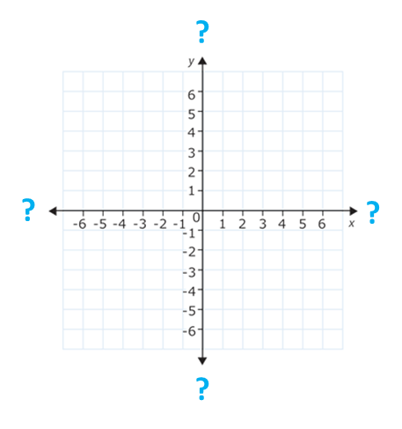
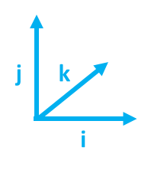
Basis vectors
We have the idea of axes in a coordinate system.
But how far should these axes extend?
We could say that they extent infinitely, but that doesn’t really help us as game programmers.
2
(3, 2)
1
We can just start out with length 1
1
2
3
We can call these the basis vectors.
Each basis vector is given a name.
They form the basis of the coordinate system.
The convention is to call them i, j, k for the x, y, z axes.
Since they are of length 1, they are called unit basis vectors.

Slide 4
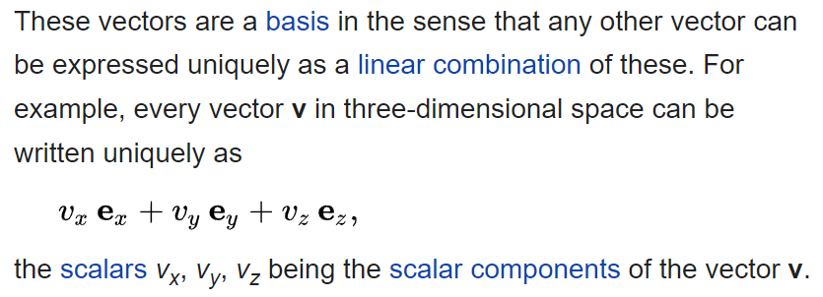
Basis vectors
y
1
https://en.wikipedia.org/wiki/Standard_basis
j
z
k
x
i
1
In simple words? →

Slide 5
Basis vectors
A 3D vector v is represented by (v_{x}, v_{y}, v_{z}).
For any vector, each coordinate value v_{x}, v_{y}, v_{z} can be expressed as some multiple of the basis vector for that coordinate’s axis.
y
Use the standard basis { i, j, k }
1
v = v_{x}i + v_{y}j + v_{z}k
v_{x}, v_{y} v_{z}
j
z
v
(1.5, 0.5, 1.0)
k
v = 1.5*i + 0.5*j + 1.0*k
x
i
1

Slide 6
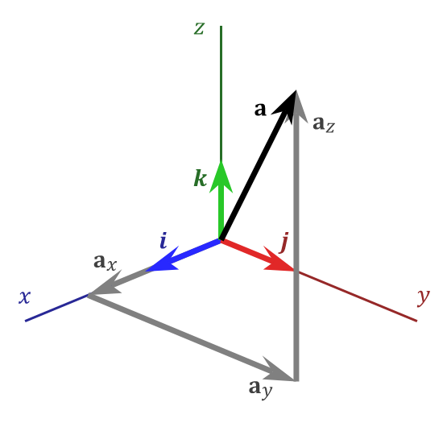
Basis vectors
We will represent vectors in Cartesian coordinate form.
A vector will be described by its:
Displacement along the x, y and z axes
Vector a = a₁i +a₂j +a₃k
You might be wondering why bother with this – it looks pretty obvious for unit basis vectors.
Watch the next video to see why the concept of basis vectors is important!

Slide 7
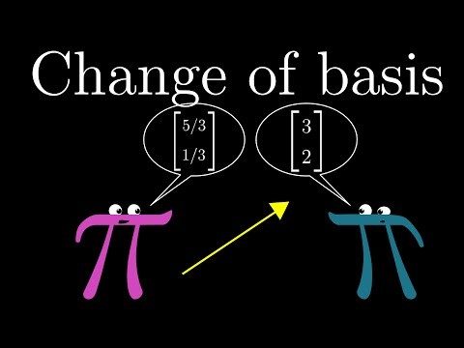
Different coordinate systems have different basis vectors.
We can transform a point from one set of basis vectors to another.

Slide 8

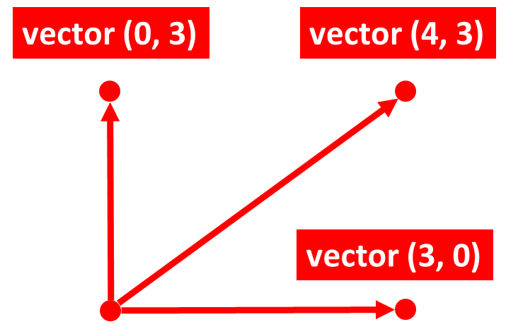

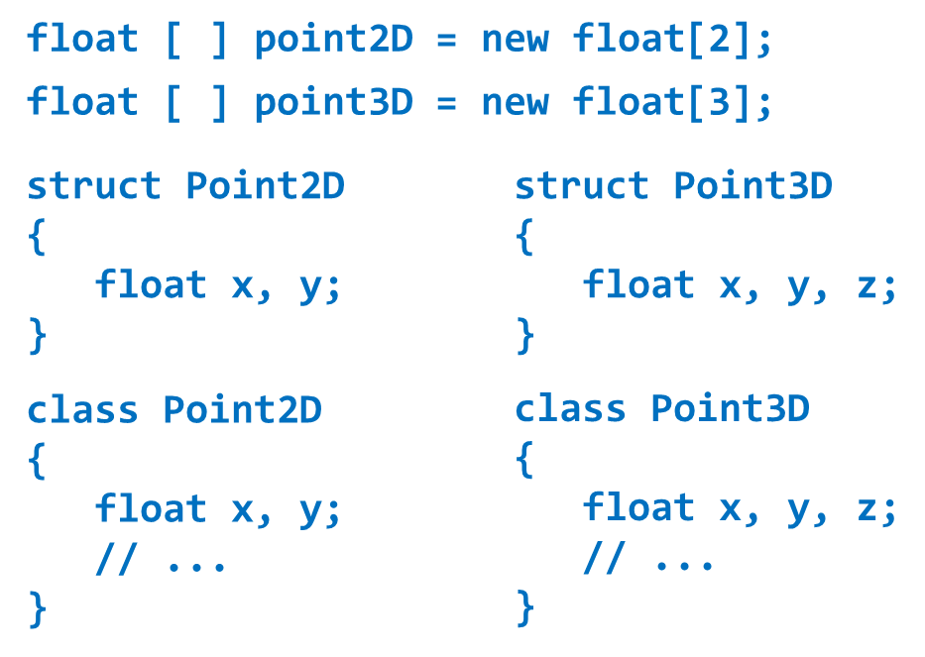

You should see that our representation of the problem(s) we try to solve become increasingly abstract
GAME
MATH
This is basically the heart of GMAPS!
Yes, GMAPS does have a heart …
CODE

Slide 9


https://anime-pictures.net/pictures/view_post/735474
Listening in class

Slide 10

QUESTION 6 - Review
Magnitude of vector = velocity
5. Set velocity
1. Click on white ball
2. Drag mouse
3. Draw line
4. Release mouse
Problems:
How to check if the mouse position is inside the ball?
How to draw the line to represent the velocity vector?
How to set the velocity of the ball?
How to move the ball according to its velocity?

Slide 11


How to check if the mouse position is inside the ball?
Distance from ball position to mouse position
Position
Radius
(x,y)
(x,y)
(x,y)
If the distance from the ball position to the mouse position is less than the ball radius, then the mouse is inside the ball.

Slide 12


